Slide 1


Detecting Bengali Hate Speech: A Machine Learning and Transformer-Based Approach
Presented By :
Sanjana Akhter : 20210104150
Md. Mostafizur Rahman : 20210104151
Mahajabin Haque : 20210104154

Slide 2

Table of contents
  Introduction
  Problem Statement
  Research Objective
  Related Works
  Dataset
  Data Preprocessing
  Methodology
  Evaluation Metrics
  Result Analysis
  Challenges and Limitation
  Conclusion

Slide 3

Introduction
Hate speech on social media is a growing concern, impacting individuals and communities. Detecting hate speech in Bengali is particularly challenging due to limited datasets and the unique nature of regional language expressions.
This research focuses on using machine learning and transformer-based models, including BanglaBERT, mBERT, and XLM-RoBERTa, to detect Bengali hate speech.

Slide 4

Problem Statement
Hate speech on social media is rising, particularly in regional languages like Bengali.
It spreads negativity, harms individuals, and disrupts online communities.
Traditional methods struggle to detect hate speech due to language nuances and informal expressions.
Bengali hate speech often includes unique cultural references and slang.
Transformer-based models, can improve detection accuracy and help mitigate this issue.

Slide 5
Research Objective
Analyze the rise of Bengali hate speech on social media and its impact.
Develop a detection model using machine learning and transformers.
Compare ML models (SVM, XGBoost, Naïve Bayes, KNN) with transformers (BanglaBERT, mBERT)
Evaluate Models effectiveness in detecting nuanced hate speech.Enhance detection by addressing dataset imbalance and improving preprocessing.

Slide 6
Related Works
Jobair et al. (2024): BERT performed best (97% accuracy) on an existing dataset but 80% on a new dataset.
Karim et al. (2023): Explored multimodal hate speech detection using text and image models. XLM-RoBERTa achieved the highest F1-score (82%)
Haider et al. (2024): Introduced a multi-label hate speech dataset for Banglish. TB-mBERT achieved 82.57% accuracy for binary classification, while BanglaBERT performed best for multi-label classification (54.08%).
Akter et al. (2024): Proposed a hybrid deep learning model (BERT + BiLSTM + SVM). BERT-CNN hybrid achieved 94.44% accuracy, outperforming LSTM and GRU.

Slide 7
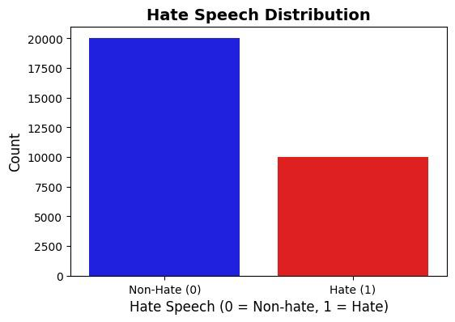
Dataset
Contains 30,000 labeled sentences ("hate" & "no hate").
Imbalanced dataset (20,000 "no hate" vs. 10,000 "hate").
Split into training (80%) and testing (20%).

Slide 8
Data Preprocessing
Text Cleaning: Removed unwanted characters, symbols, English words, numbers, and extra spaces to retain only Bengali text.
Tokenization: Used the Indic NLP library to break text into words.
Stopword Removal: Applied NLTK stopwords list
Encoding: Converted tokenized text into numerical representations for transformer models
Balanced Class Distribution: Addressed dataset imbalance (20,000 "no hate" vs. 10,000 "hate") to improve model learning.

Slide 9
Methodology
Machine Learning Models
  Applied SVM, Naïve Bayes, Gradient Boosting , KNN, XGBoost for classification.
  Traditional ML models struggled with language complexity and class imbalance.
Transformer-Based Models
  BanglaBERT: Language-specific model trained on large-scale Bengali text.
  mBERT: Multilingual BERT model tested in cased & uncased versions.
  XLM-RoBERTa: Cross-lingual model optimized for code-mixed Bengali text.

Slide 10
Methodology
Hyperparameter Tuning
  Adjusted learning rates, batch sizes and optimization strategies for better performance.
  Used AdamW optimizer and weighted cross-entropy to handle class imbalance.
Model Evaluation
  Assessed models using accuracy, precision, recall, F1-score, and confusion matrix.
  ML models performed poorly on minority class, while BanglaBERT outperformed others.

Slide 11
Evaluation Metrics
Accuracy: Indicates the proportion of correctly classified hate speech.
Precision: Reflects the model's effectiveness in accurately detecting hate speech
Recall: Measures the model’s capability to capture all instances of hate speech.
F1-Score: Serves as a harmonic mean, balancing precision and recall.

Slide 12
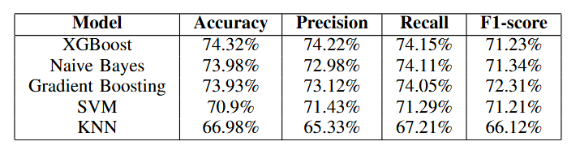
Result Analysis
Machine Learning model performance comparison :

Slide 13
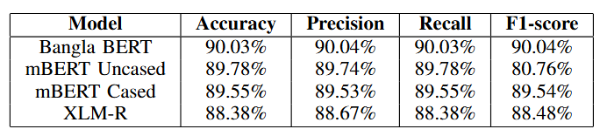
Result Analysis
Transformer Based Models Performance Comparison :

Slide 14
Challenges and Limitations:
Data Imbalance: More "no hate" than "hate" samples affect model accuracy.
Language Complexity: Slang, sarcasm, and cultural nuances make detection difficult.
Computational Cost: Transformer models require high processing power.
ML Model Limitation: Traditional ML models struggle to detect the minority class (hate speech).

Slide 15
Conclusion
Our research shows that transformer-based models, particularly BanglaBERT, are more effective than traditional machine learning models for Bengali hate speech detection. Future work will focus on expanding the dataset, improving model performance, and exploring advanced techniques like combining transformers with deep learning models.

Slide 16
Thank You

